Slide 1

Smart Land Registration in BD: A Blockchain-Based Architecture for Decentralized Land Governance and Secure Registration
Thesis Final_Defense – Fall 2025
30 January 2026
Presented By,
Khondokar Saim – 221902353
Hasnat Zamil Sayad– 221902001
Ibrahim Al Rifat– 221902208
Supervisor’s-
Ms. Farhana Akter Sunny
Assistant Professor, Dept of CSE at GUB
Mr. Mozdaher Abdul Quader
Lecturer, Dept of CSE at GUB
Department of Computer Science and Engineering
Green University of Bangladesh
Notes:
Slide 1: Title Slide
Write Script Here .

Slide 2

Table of Contents
Introduction
Background
Problem Statement
Motivation
Objectives
Literature Review
Related Studies
Research Gap
Methodology
Approach
Research Design
Data Collection Methods
Data Analysis Methods
Results & Discussion
Key Finding
Comparison
Performance Analysis
Conclusion
Contributions
Limitations
Future Works
References
Question & Answer Session
Notes:
This is our presentation table of contents.

Slide 3


Introduction
Notes:
Let’s explain the introduction.

Slide 4
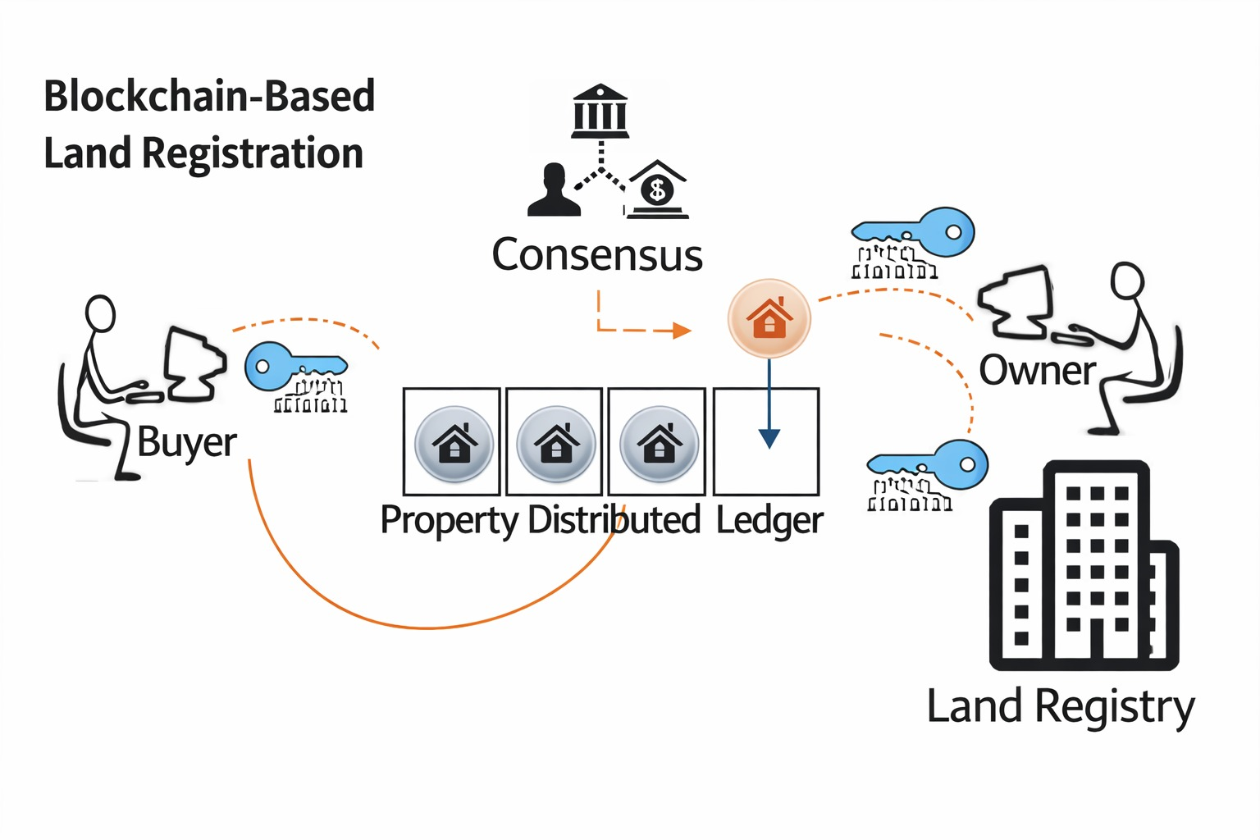
Background
Georgia, Sweden, and the Netherlands have already adopted blockchain
Still face corruption, delays, and data security risks
Figure 1.0 : Blockchain-Based Land Registration Workflow
Notes:
Slide 4: Introduction
Write Script For this Slide Here .

Slide 5
Problem Statement (1/3)
Land services face fake documents and long delays.
Different government offices keep separate land records, which creates confusion.
Central online systems are also risky, such as the 2023 hacking of 50 million citizen records.
Normal blockchain systems like PoW and DPoS are too costly and slow for government use.
Notes:
Slide 4: Introduction
Write Script For this Slide Here .

Slide 6
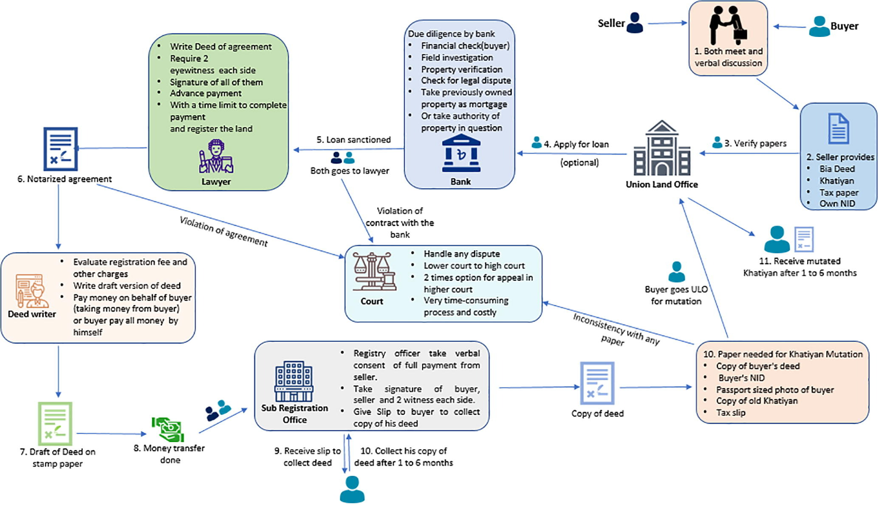
Problem Statement (2/3)
Figure 2.0 : Existing land title management system of Bangladesh
Notes:
Slide 4: Introduction
Write Script For this Slide Here .

Slide 7
Problem Statement (3/3)
The process is highly manual and fragmented, involving many intermediaries (lawyer, deed writer, bank, sub-registry, court, land office), which causes long delays, repeated verification, and frequent human errors.
Because it mostly depends on paper documents and verbal checks, records can be easily changed or faked and lengthy court cases.
There is no single trusted system, so mismatched records often lead to disputes and long delays, resulting in disputes and 1-6 month delays even after registration.
Notes:
Slide 4: Introduction
Write Script For this Slide Here .

Slide 8
Motivation
There is a strong need for a secure, scalable, and tamper-resistant land registration framework.
Large projects like Purbachal New Town reveal that current systems cannot securely handle high transaction volumes.
Real-world corruption cases and unofficial payments in land services highlighted systemic weaknesses.
Major data breaches exposed the risks of centralized land record databases.
Successful blockchain-based land registry initiatives in other countries showed practical benefits.
Notes:
Slide 4: Introduction
Write Script For this Slide Here .

Slide 9
Objectives
To develop an Property Transaction Process via Digital Portal to handle stamp obtaining and stamp duty payment digitally.
To develop an Digital Verification Protocols for Title Transfers to manage ownership transfer transactions between buyers and sellers.
To design a Network Structure for the System to support structured and transparent transaction flow.
To get Gas cost Analysis for different transaction operations in Land Registration.
Notes:
Slide 4: Introduction
Write Script For this Slide Here .

Slide 10

Literature Review
Notes:
Slide 11: Literature Review
To build our system, we studied other related research and papers.
We found that many existing systems use blockchain but still have some problems, like high cost, lack of real-time data, and no support for updates.

Slide 11
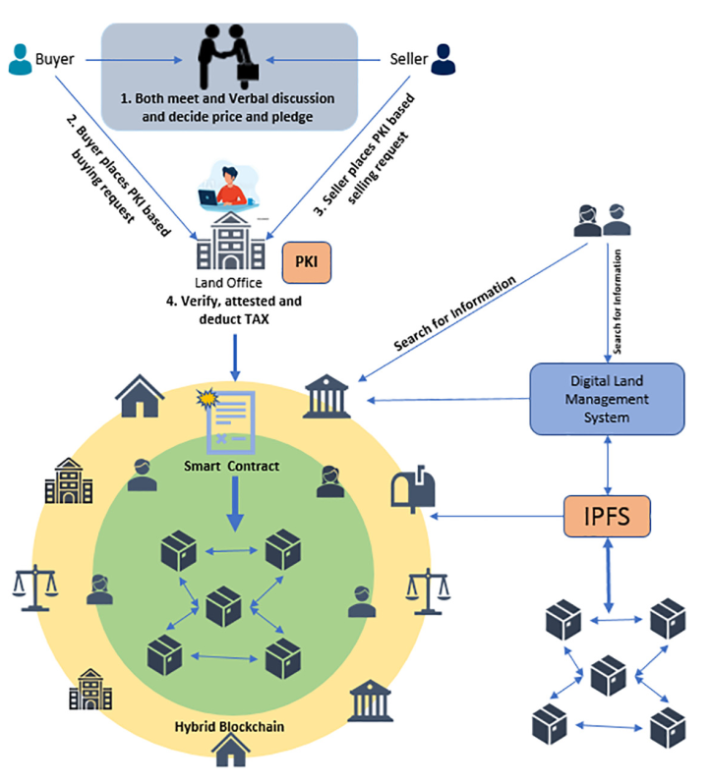
Related Studies (1/6)
Title: A Blockchain-based Land Title Management System for Bangladesh
Methodology:
Figure 3.0 : Proposed incremental Blockchain adoption model for land title management of Bangladesh.
Notes:
Slide 4: Introduction
Write Script For this Slide Here .

Slide 12
Related Studies (2/6)
Achievement:
Introduced phase wise Public to Hybrid blockchain roadmap.
Implemented Ethereum smart contract prototype reducing cost and delays.
Limitations:
Needs strong government laws and institutional adoption.
Public blockchain mining not scalable for all citizens.
Gas price volatility makes real-world cost uncertain.
Reference:
K. M. Alam, J. M. A. Rahman, A. Tasnim and A. Akther,"Blockchain-Based Land Title Management System for Bangladesh," Journal of King Saud University – Computer and Information Sciences, 2020, doi: 10.1016/j.jksuci.2020.10.011.
Notes:
Slide 4: Introduction
Write Script For this Slide Here .

Slide 13
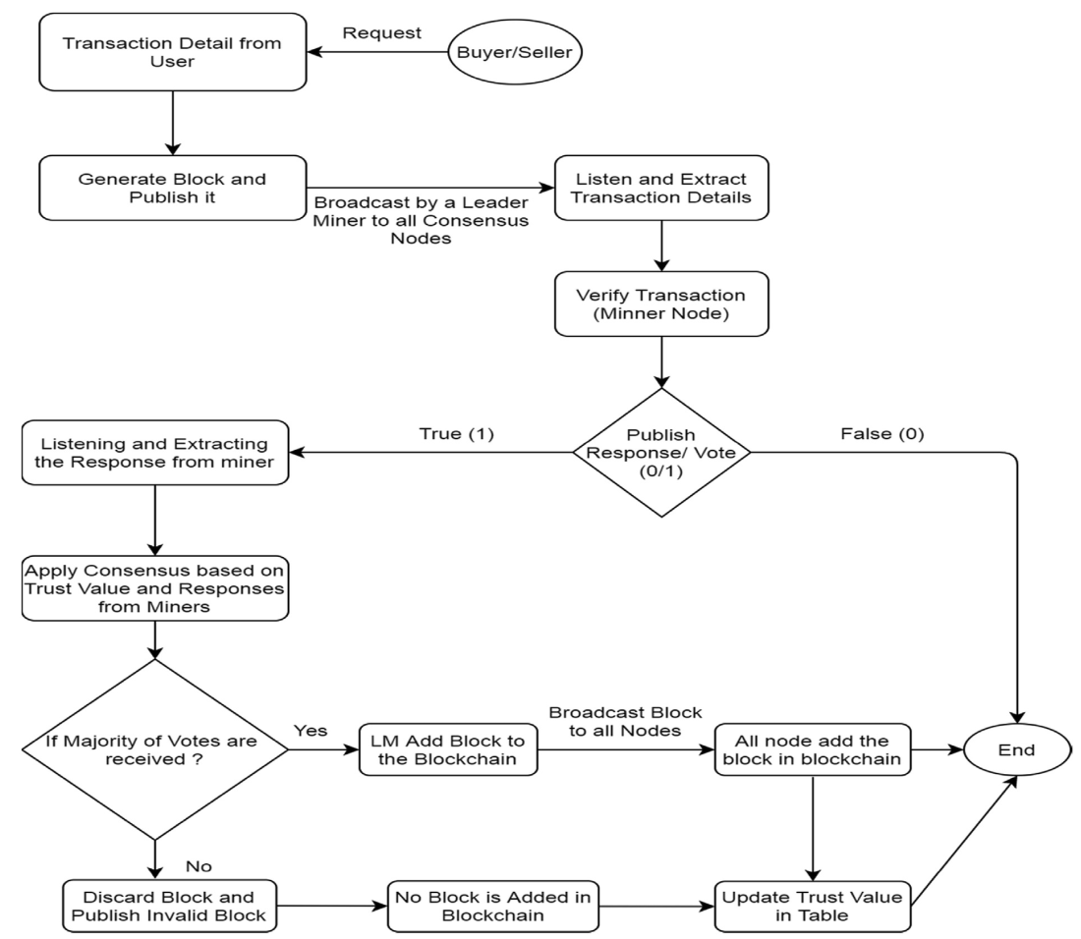
Related Studies (3/6)
Title: Distributed Ledger Technology based Land Transaction System with Trusted Nodes Consensus Mechanism
Methodology:
Figure 4.0 : Work Flow of the Proposed System
Notes:
Slide 4: Introduction
Write Script For this Slide Here .

Slide 14
Related Studies (4/6)
Achievement:
Introduced Trusted Node Consensus Algorithm (TNCA) using miner trust values
Reduced message overhead by 58.94% and improved block addition time by 26.44% vs PoW
Limitations:
Trust value table maintenance increases computation cost in large networks.
Framework assumes government-controlled validator participation.
Consensus accuracy depends strongly on correct trust evaluation.
Reference:
A. S. Yadav, S. Agrawal and D. S. Kushwaha,"Distributed Ledger Technology Based Land Transaction System With Trusted Nodes Consensus Mechanism," Journal of King Saud University – Computer and Information Sciences, 2021, doi: 10.1016/j.jksuci.2021.02.002.
Notes:
Slide 4: Introduction
Write Script For this Slide Here .

Slide 15
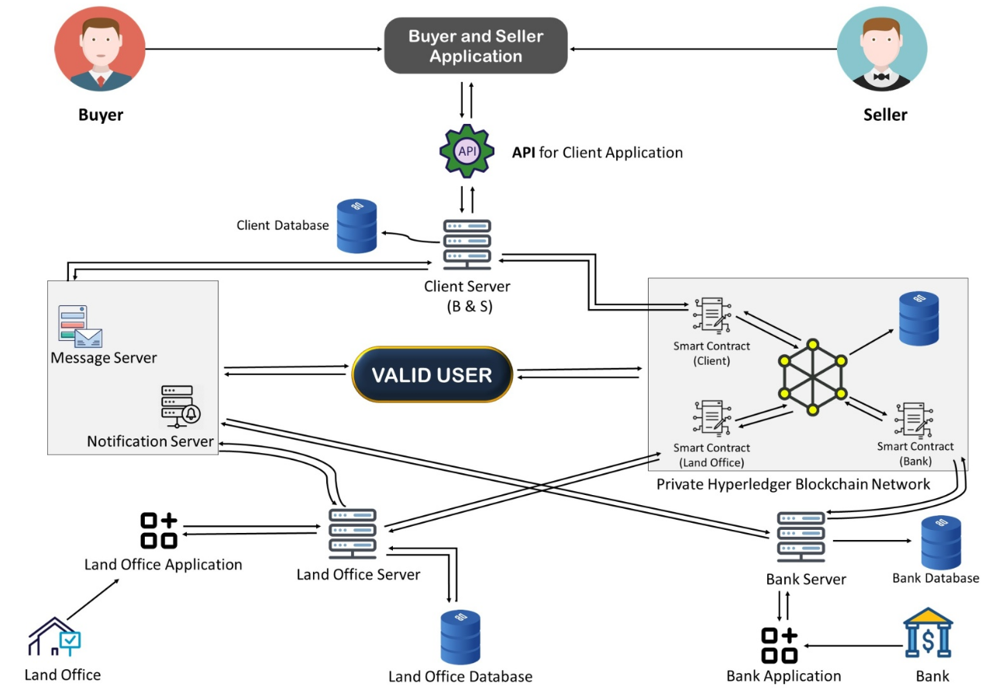
Related Studies (5/6)
Title: A Blockchain Based Land Registration and Ownership Management System for Bangladesh
Methodology:
Figure 5.0 : System architecture of the proposed system.
Notes:
Slide 4: Introduction
Write Script For this Slide Here .

Slide 16
Related Studies (6/6)
Achievement:
Proposed a permissioned Hyperledger Fabric-based land ownership system.
Improved transparency and removed intermediaries to reduce fraud.
Limitations:
No consensus mechanism defined for buyer–seller transaction completion.
Assumes full participation of banks and government stakeholders.
Reference:
R. I. Shithy, N. Mohammad, H. N. A. Ruhullah, S. M. Y. Oni and Md. Al-Amin, "A Blockchain Based Land Registration and Ownership Management System for Bangladesh," in Proceedings of the 2021 4th International Conference on Blockchain Technology and Applications (ICBTA 2021), Xi’an, China, Dec. 2021, pp. 1–7, doi: 10.1145/3510487.3510501.
Notes:
Slide 4: Introduction
Write Script For this Slide Here .

Slide 17
Research Gap
Table 1.0 : Research Gap from Existing Systems..
Gap | What Existing Systems Lack | Why Our work is needed
1 | Large-scale testing with realistic networks | Our work evaluates performance up to 1000 validator nodes, matching district-level deployment in Bangladesh
2 | Cross-consensus comparison across families | our compares PoW, DPoS, RLSCA, TNCA to justify a government-suitable consensus choice
3 | Clear governance, onboarding, and legal integration | our work aligns validation with administrative jurisdictions and supports existing land laws
4 | Detailed gas consumption and transaction cost benchmarking for core land registration operations | our work provides operation-wise gas profiling (deployment, registration, mutation, identity setup), ensuring economic scalability and practical feasibility for Bangladesh
5 | Privacy-safe decentralized architecture | our work combines permissioned blockchain + IPFS, reducing data leakage and corruption risks
Notes:
Slide 4: Introduction
Write Script For this Slide Here .

Slide 18

Methodology
Notes:
Slide 15: Methodology
✨ Now I would like to introduce my teammate, Rabby Khan.
He will continue with the next part of our presentation.

Slide 19
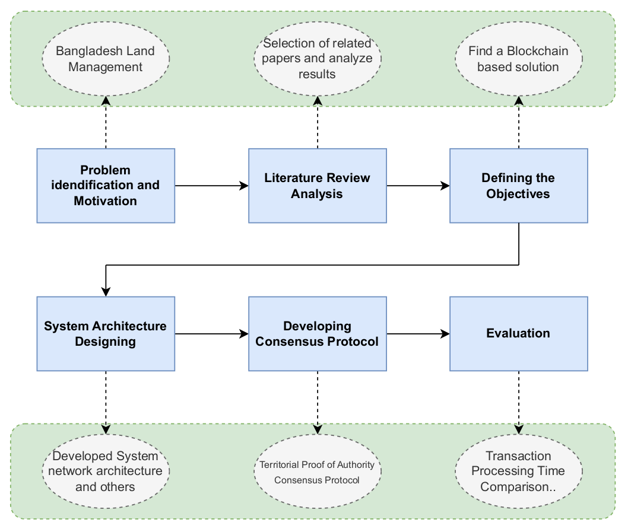
Block Diagram of Research Methodology
Figure 6.0 : Block Diagram of Research Methodology Overview.
Notes:
Slide 4: Introduction
Write Script For this Slide Here .

Slide 20
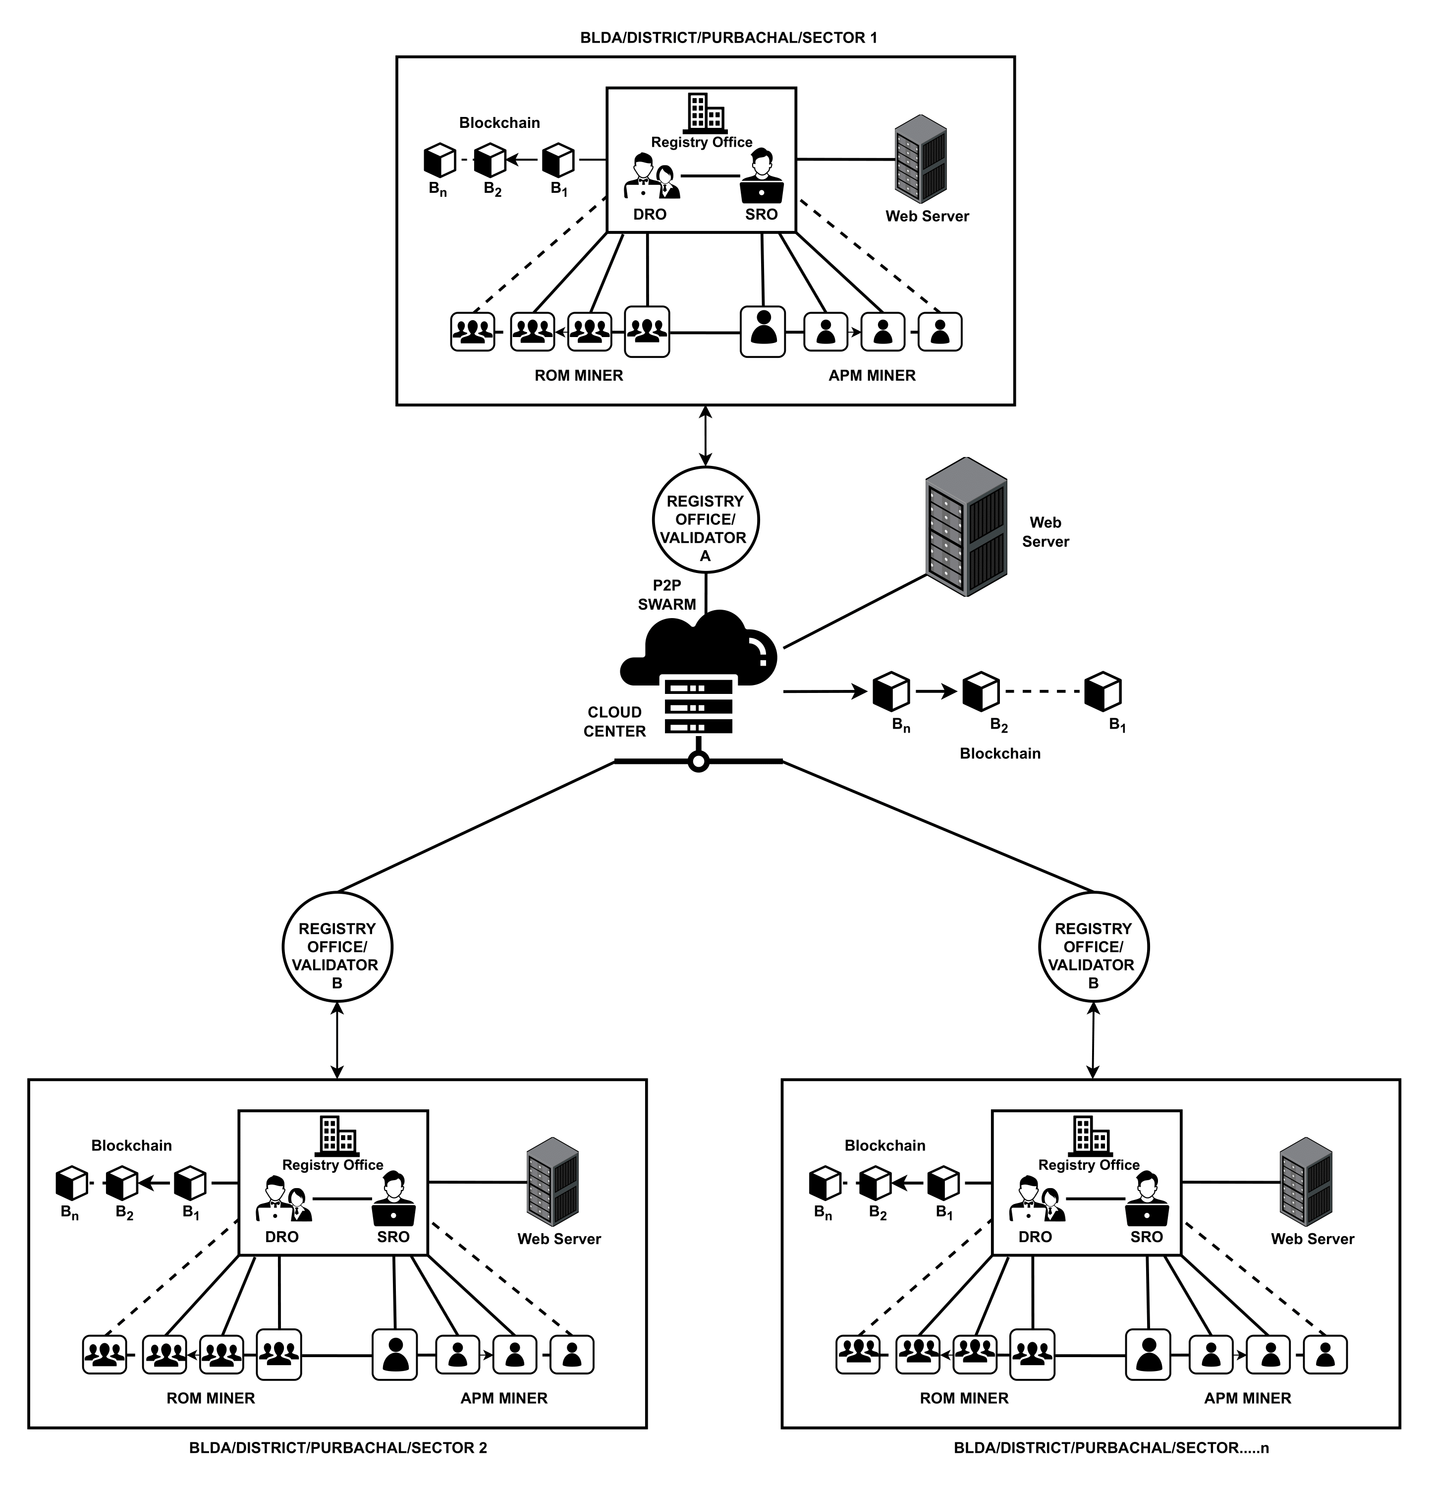
Network Structure for the System (1/3)
Figure 7.0 : Network Structure for the System.
Notes:
Slide 4: Introduction
Write Script For this Slide Here .

Slide 21
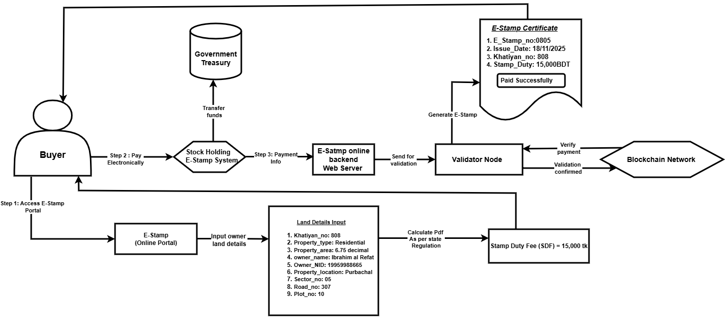
Property Transaction Process via Digital Portal (2/3)
Figure 7.0 : Property Transaction Process via Digital Portal.
Notes:
Slide 4: Introduction
Write Script For this Slide Here .

Slide 22
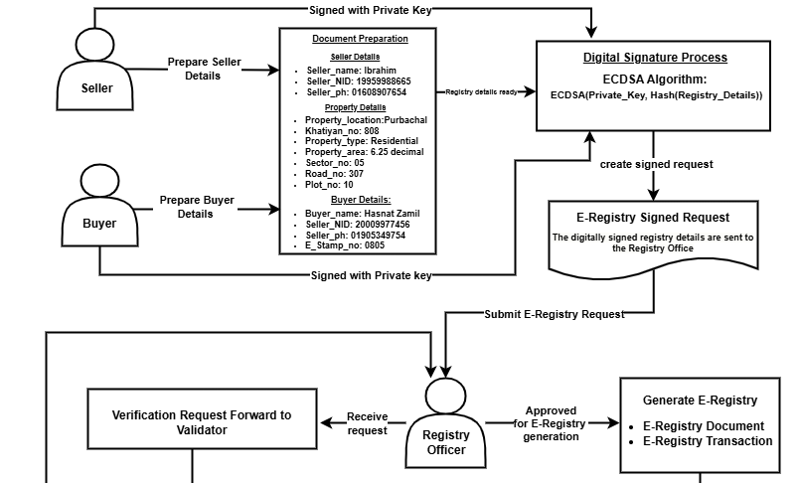
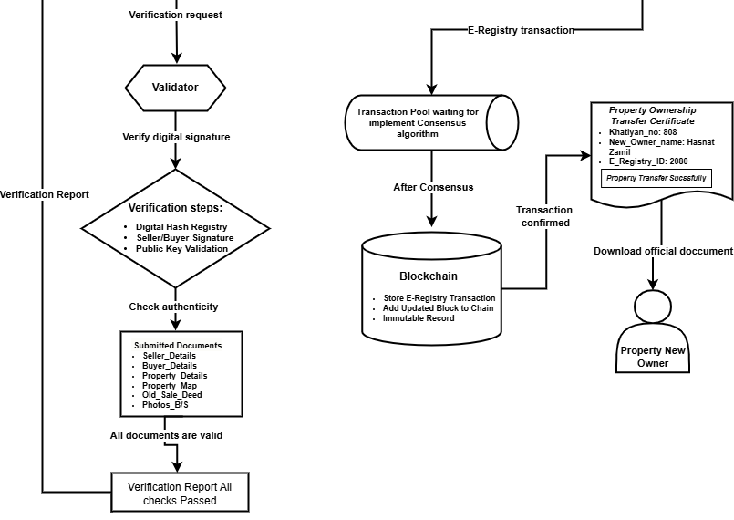
Digital Verification Protocols for Title Transfers (3/3)
Figure 8.0 : Digital Verification Protocols for Title Transfers.
Notes:
Slide 4: Introduction
Write Script For this Slide Here .

Slide 23
Data Collection Methods (1/2)
Territorial Message Exchange Reduction & Transaction Processing Time Data Collection Method.
Table 2.0 : Territorial Message Exchange Reduction & Transaction Processing Time Data Collection Method.
Aspect | Description
Data Sources | Realtime simulation-generated blockchain event logs, validator performance data, transaction timestamps, and network message traces; baseline data for PoW and other consensus protocols.
Tools | Python-based simulation in Google Colab; structured logging using CSV/JSON; data handling with Pandas.
Sampling | Stratified sampling across 64 districts with network sizes ranging from 10–1000 nodes and multiple transaction runs per configuration.
Validity & Reliability | Ensured through event-driven data capture, controlled simulation settings, repeated runs, and immutable audit trails.
Notes:
Slide 4: Introduction
Write Script For this Slide Here .

Slide 24
Data Collection Methods (2/2)
Gas Consumption and Cost Data Collection Method.
Table 3.0 : Gas Consumption and Cost Data Collection Method..
Rubric Item | Content
Sources of Data | Primary: Transaction receipts (gasUsed, txHash, status) from on-chain executions Secondary: IPFS land records (metadata + hashes) for realistic scenarios
Tools / Instruments | Web3 simulation interface + IPFS connector Remix Ethereum IDE (Solidity execution) MetaMask (signing) Ganache (local chain + dummy ETH)
Sampling Technique & Size | Purposive sampling from 100 IPFS land records 50 for Initial Khatian Registration 50 for Ownership Mutation (Transfer)
What Was Measured | Smart Contract Deployment Initial Khatian Registration Khatian Mutation Transfer User Identity Registration
Notes:
Slide 4: Introduction
Write Script For this Slide Here .

Slide 25
Data Analysis Methods (1/2)
Territorial Message Exchange Reduction & Transaction Processing Time Data Anaysis Method.
Table 4.0 : Territorial Message Exchange Reduction & Transaction Processing Time Data Anaysis Method...
Aspect | Description
Techniques | Statistical and model-based analysis comparing TPACP with PoW and other consensus protocols.
Processing | Event logs are aggregated per transaction and network size to compute message exchange and processing time metrics.
Software | Python (Google Colab) using Pandas, NumPy, and Matplotlib.
Research Alignment | Analysis evaluates scalability (message reduction), efficiency (processing time), and integrity (verification outcomes).
Notes:
Slide 4: Introduction
Write Script For this Slide Here .

Slide 26
Data Analysis Methods (2/2)
Gas Consumption and Cost Data Analysis Method
Table 5.0 : Gas Consumption and Cost Data Analysis Method
Rubric Item | Content
Techniques Used | Descriptive analysis of gasUsed per operation (representative/average values) .Cost modelling: Gas Cost = gasUsed × gasPrice
How Data Were Processed | Execute each function in Remix Extract receipt data (gasUsed, status, txHash) from Web3/Ganache/Remix Compute cost using benchmark 20 Gwei
Software / Platform | Remix + Solidity MetaMask + Ganache Web3 interface
Aligned with Research Questions | Evaluates economic feasibility (transaction cost) Evaluates operational efficiency (gas consumption) for core land registry operations
Notes:
Slide 4: Introduction
Write Script For this Slide Here .

Slide 27

Results and Discussion

Slide 28
Key Finding (1/5)
Simulation Environment:
Table 6.0 : Simulation Environment:
Main Category | Sub Category | Description
Simulation Setup | Network Model | District-based blockchain network reflecting Bangladesh’s land registry system
 | Validator Structure | Validators represent Sub-Registry and District Registry offices
 | Network Scale | Network size evaluated from 10 to 1000 nodes for scalability testing
Technical Environment | Operating System | Ubuntu 22.04.5 LTS
 | Distributed Storage | InterPlanetary File System (IPFS)
 | Programming Tools | Python 3, Solidity (Smart Contract Development)
 | Consensus Baselines | PoW, DPoS, RLSCA, TNCA + Gas Consumption Analysis
 | Performance Metrics | Message exchange volume, transaction processing time, and gas consumption cost for land operations
 | Experimental Stability | Multiple iterations with statistical averaging for reliable results
Notes:
Slide 4: Introduction
Write Script For this Slide Here .

Slide 29
Key Finding (2/5)
Performance Metrics:
Table 7.0 : Performance Metrics
Territorial Communication Efficiency
What it Measures | Message exchange overhead during the consensus process
Why it Matters | Lower message overhead improves scalability, especially in poor or unstable network conditions
Transaction Processing Time
What it Measures | Time taken from property submission to final immutable blockchain record
Why it Matters | Faster processing reduces administrative delays and limits opportunities for corruption
Gas Consumption and Cost Analysis
What it Measure | Gas units required by smart contract operations such as deployment, khatian registration, ownership mutation, and identity setup
Why it Matters | It shows how expensive blockchain transactions are and whether the system is affordable to use at scale in Bangladesh
Notes:
Slide 4: Introduction
Write Script For this Slide Here .

Slide 30
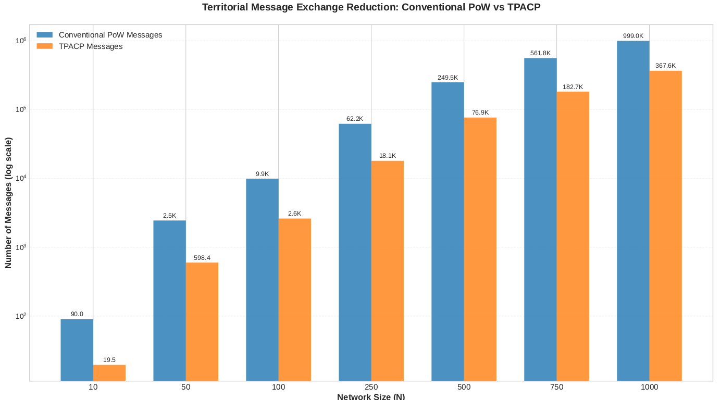
Key Finding (3/5)
Visual Result – Message Exchange Reduction
Figure 9.0 : Territorial Messeage Exchange Reduction: Conventional PoW vs TPACP.
Notes:
Slide 4: Introduction
Write Script For this Slide Here .

Slide 31
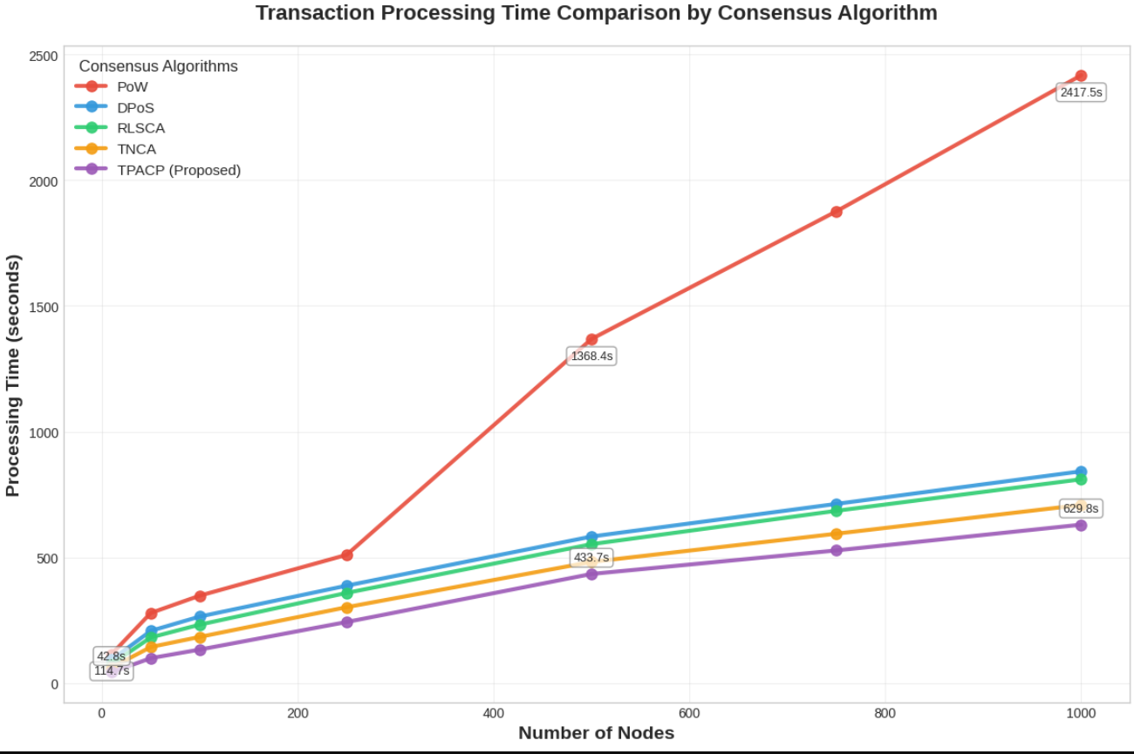
Key Finding (4/5)
Visual Result – Transaction Processing Time
Figure 10.0 : Transaction Processing Time Comparison by Consensus Algorithm.
Notes:
Slide 4: Introduction
Write Script For this Slide Here .

Slide 32
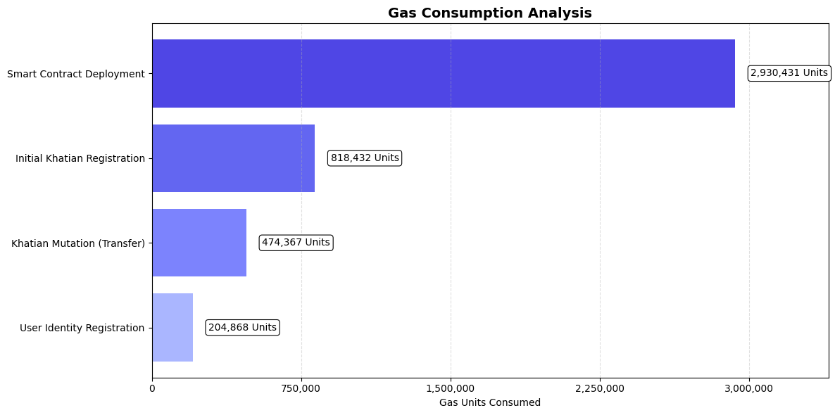
Key Finding (5/6)
Visual Result – Gas Consumption and Cost for Different Transaction Operations
Figure 11.0 : Gas Consumpton Analysis for Different Transaction Operations.
Notes:
Slide 4: Introduction
Write Script For this Slide Here .

Slide 33
Key Finding (6/6)
Core outcomes of the Visual Result
Average 56.8% reduction in message overhead vs PoW
Up to 74% faster transaction processing at large scale
Stable performance from 10 to 1000 nodes
Overall, routine transactions such as registration (818,432 g.units),mutation (474,367 g.units), and identity setup (204,868 g.units) consume far less gas than deployment (2,930,431 g.units) and resulting the system is economically scalable for Bangladesh land regestration scenario.
Notes:
Slide 4: Introduction
Write Script For this Slide Here .

Slide 34
Comparison
Table 8.0 : Comparison with Existing Related Studies with proposed TPACP
Aspect | Existing Related Studies | Limitation in Prior Works | Contribution of Proposed TPACP
Land Registry Blockchain Models | Shithy et al. proposed blockchain-based land registration frameworks | Mostly conceptual; lacks full-scale economic and governance evaluation | TPACP introduces territorially governed blockchain suitable for Bangladesh administration
Transaction Processing Time | A. S. Yadav et al., Processing times reported for PoW, PoS, DPoS, and TNCA (e.g., at 100 nodes: PoW 358.2 s, DPoS 252.4 s, TNCA 153.6 s) | Evaluated only up to 350 nodes and without advanced authority-based optimization | TPACP achieves lower times at larger scale (e.g., 132.9 s at 100 nodes, 629.0 s at 1,000 nodes), demonstrating scalable and faster processing
Gas Consumption Benchmarking | Alam et al., Final Avg. gas costs reported (e.g., deployment 3,084,664, khatian entry 442,408, mutation 499,334, user 215,650) | Values reported without unified workflow or benchmark consistency | TPACP provides standardized gas benchmarks (deployment 2,930,431, registration 818,432, mutation 474,367, identity 204,868) enabling direct, reproducible comparison
Notes:
Slide 4: Introduction
Write Script For this Slide Here .

Slide 35
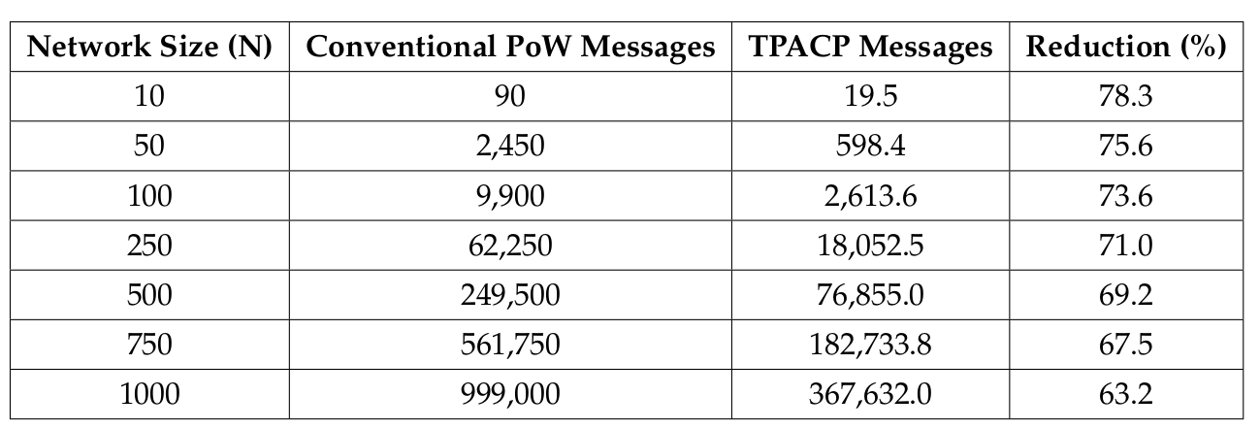
Performance Analysis (1/3)
Table 9.0 : Territorial Message Exchange Reduction Compared to Proof of Work (PoW)
10 nodes: TPACP reduces message overhead by 78.3% (highest efficiency).
500 nodes: Still achieves 69.2% reduction, showing good scalability
1000 nodes: Maintains 63.2% reduction, proving robustness for large nationwide networks
Notes:
Slide 4: Introduction
Write Script For this Slide Here .

Slide 36
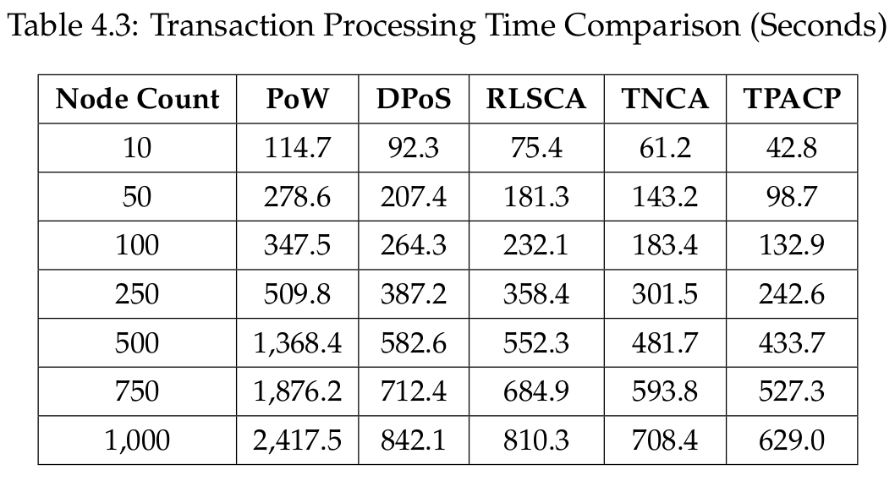
Performance Analysis (1/3)
Table 10.0 : Transaction Processing Time Comparison (Seconds)
At 1000 nodes, TPACP also outperforms other protocols:
25.2% better than TPoS
22.3% better than RLSCA
11.1% better than TNCA
Notes:
Slide 4: Introduction
Write Script For this Slide Here .

Slide 37
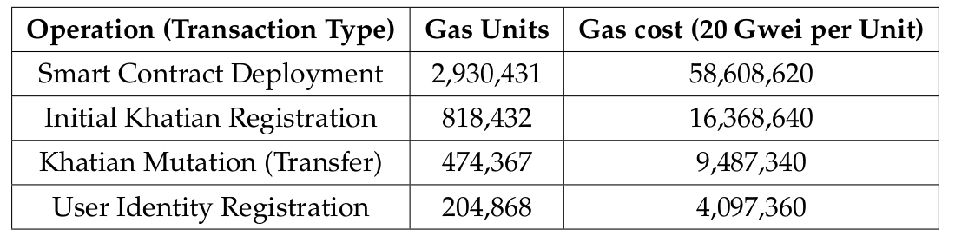
Performance Analysis (1/3)
Table 11.0 : Gas Consumption and Cost for Different Transaction Operations
Smart contract deployment has the highest gas cost (2,930,431 gas), reflecting the main one-time setup expense.
Routine land operations like khatian registration (818,432 gas) and mutation/transfer (474,367 gas) consume much less gas, ensuring practicality.
User identity registration requires the lowest gas (204,868 gas), showing efficient authentication processing.
Notes:
Slide 4: Introduction
Write Script For this Slide Here .

Slide 38

Conclusion

Slide 39
Contributions
TPACP Consensus Methodology Introduces a territorial, performance-weighted consensus protocol aligned with district-based land administration.
Performance-Driven Evaluation Framework Assesses scalability using message exchange volume and transaction processing time across 10–1000 nodes, benchmarked against PoW, DPoS, RLSCA, and TNCA.
Gas Consumption & Cost Analysis Provides numerical gas usage and transaction cost measurements for core land operations, enabling objective assessment of economic feasibility.
Notes:
Slide 4: Introduction
Write Script For this Slide Here .

Slide 40
Limitations
Tests were done in a simulation, not in a real government environment.
All districts were assumed to have similar systems and documents, which is not always true in practice.
Very heavy transaction loads were not tested.
These issues can be improved in future real-world implementations.
Notes:
Slide 4: Introduction
Write Script For this Slide Here .

Slide 41
Future Works
In future, TPACP can be improved by selecting validators more dynamically based on real-time network performance.
Since this work is simulation-based, a real pilot implementation across districts in Bangladesh would strengthen its practical validity.
Smart contracts can be further optimized to reduce gas usage for repeated operations like registration and ownership transfer.
Notes:
Slide 4: Introduction
Write Script For this Slide Here .

Slide 42
References (1/2)
[1] K. M. Alam, J. A. Rahman, A. Tasnim, and A. Akther, “A blockchain-based land title management system for bangladesh,” Journal of King Saud University-Computer and Information Sciences, vol. 34, no. 6, pp. 3096–3110, 2022.
[2] A. S. Yadav, S. Shikha, S. Gupta, and D. S. Kushwaha, “The efficient consensus algorithm for land record management system,” IOP Conference Series: Materials Science and Engineering, vol. 1022, p. 012090, jan 2021.
[3] A. S. Yadav, S. Agrawal, and D. S. Kushwaha, “Distributed ledger technology based land transaction system with trusted nodes consensus mechanism,” Journal of King Saud University-Computer and Information Sciences, vol. 34, no. 8, pp. 6414– 6424, 2022.
[4] A. M. Munir Hussain, “Reputation-based leader selection consensus algorithm with rewards for blockchain technology,” Computers, vol. 14, no. 1, p. 20, 2025.
[5] R. I. Shithy, N. Mohammad, H. A. Ruhullah, S. Y. Oni, and M. A. Amin, “A blockchain based land registration and ownership management system for bangladesh,” in Proceedings of the 2021 4th International Conference on Blockchain Technology and Applications, pp. 94–100, 2021.
[6] S. Nakamoto, “Bitcoin: A peer-to-peer electronic cash system,” 2008.
[7] D. Larimer, “Delegated proof-of-stake (dpos),” Bitshare whitepaper, vol. 81, p. 85, 2014.
Notes:
Slide 4: Introduction
Write Script For this Slide Here .

Slide 43
References (2/2)
[8] S. M. H. Bamakan, A. Motavali, and A. B. Bondarti, “A survey of blockchain consensus algorithms performance evaluation criteria,” Expert Systems with Applications, vol. 154, p. 113385, 2020.
[9] W. Wang, D. T. Hoang, P. Hu, Z. Xiong, D. Niyato, P. Wang, Y. Wen, and D. I. Kim, “A survey on consensus mechanisms and mining strategy management in blockchain networks,” Ieee Access, vol. 7, pp. 22328–22370, 2019.
[10] B. O. Ansah, W. Voss, K. O. Asiama, and I. Y. Wuni, “A systematic review of the institutional success factors for blockchain-based land administration,” Land use policy, vol. 125, p. 106473, 2023.
[11] S. Banerjee, K. Kumar, P. Masulkar, R. Amin, and S. K. Dwivedi, “Blockchain and ipfs-based reliable land registry system,” Security and Privacy, vol. 5, no. 5, p. e236, 2022
[12] J. P. Paavo, R. Rodr´ıguez-Puentes, and U. E. Chigbu, “Practicality of blockchain technology for land registration: A namibian case study,” Land, vol. 14, no. 8, p. 1626, 2025.
[13] K. S. and G. Sarath, “Securing land registration using blockchain,” Procedia Computer Science, 2020.
[14] R. M. Zein and H. Twinomurinzi, “Blockchain technology in lands registration: A systematic literature review,” JeDEM-eJournal of eDemocracy and Open Government, vol. 15, no. 2, pp. 1–36, 2023.
Notes:
Slide 4: Introduction
Write Script For this Slide Here .

Slide 44

Q&A Session
Any Questions or Suggestions?
Notes:
Slide 4: Introduction
Write Script For this Slide Here .

Slide 45
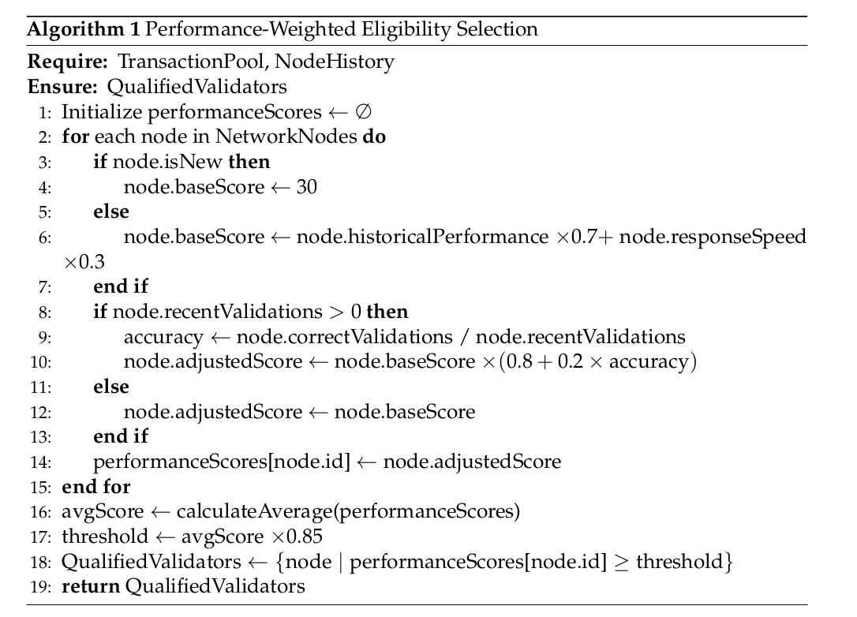
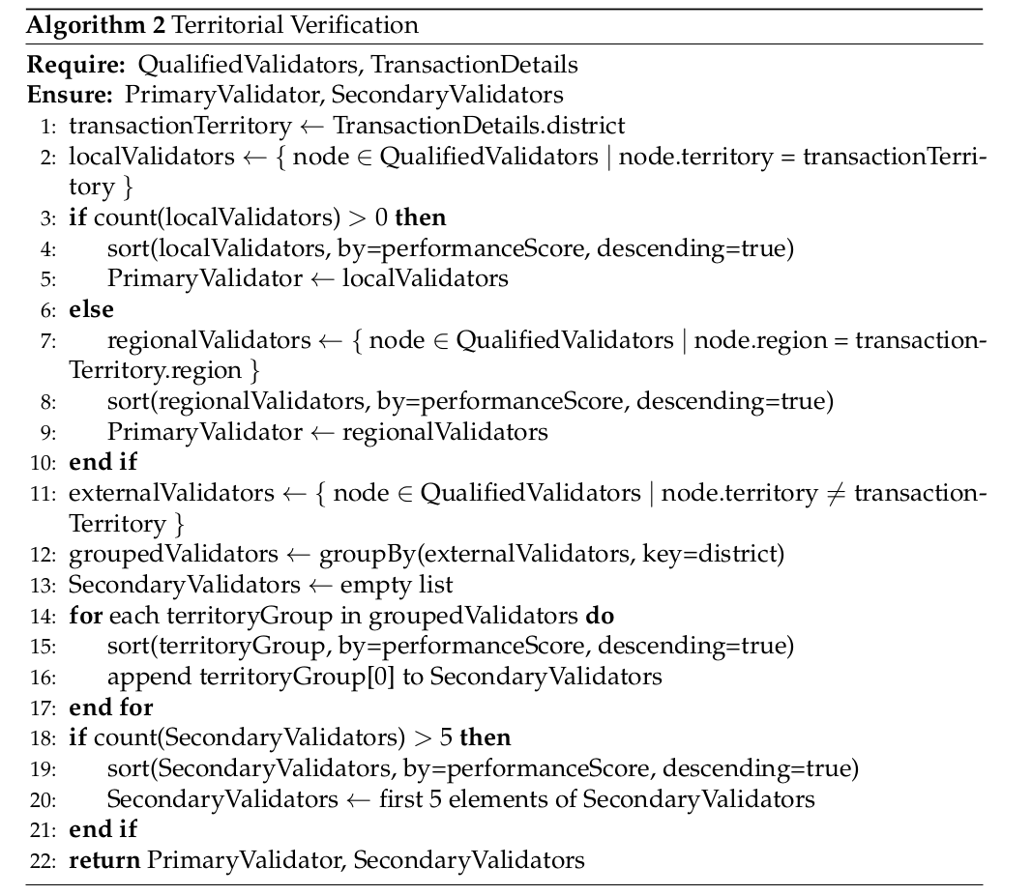
Proposed TPACP Algorithm (1/2)
Algorithm 1.0: Performance-Weighted Node Eligibility
Algorithm 2.0: Territorial Verification Framework
Notes:
Slide 4: Introduction
Write Script For this Slide Here .

Slide 46
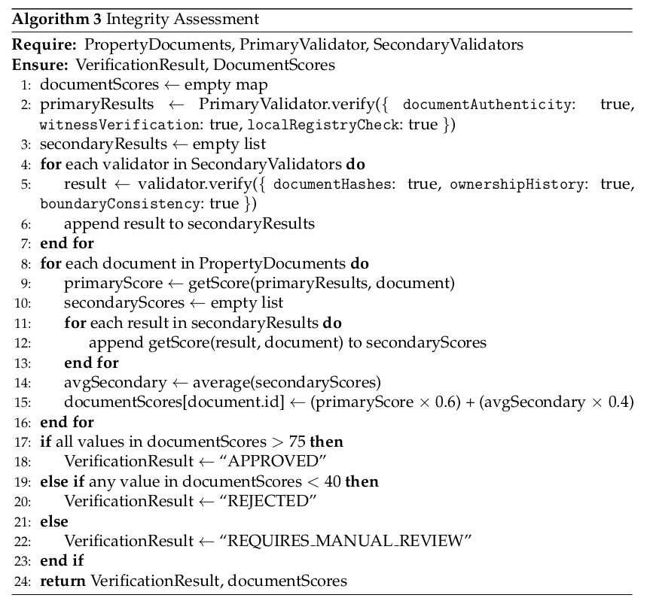
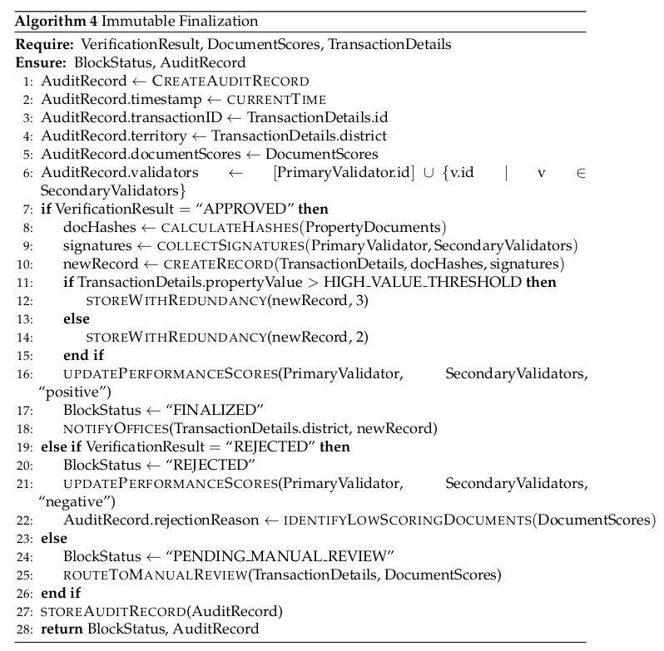
Proposed TPACP Algorithm (2/2)
Algorithm 3.0: Document Integrity Assessment
Algorithm 3.0: Immutable Record Finalization
Notes:
Slide 4: Introduction
Write Script For this Slide Here .

Slide 47

Thank You

